Slide 1


Design Of Electric Vehicle-Battery pack
Review-2
AY 2025-26
Capstone Project – Introduction (PROJ2999)
GITAM (Deemed-to-be) University
Department of Electrical Electronics and Communication Engineering
Project Team:
B.SAI KALYAN(BU22EECE0200026)
K.KEERTHI(BU22EECE0200010)
Project Mentor:
Mr K.Lokeshwara rao
Project In-charge:
Dr.Kshitiji Shakya
www.gitam.edu

Slide 2
Objective and Goals
Objective
To design and analyze a Lithium-ion battery pack for an electric vehicle that ensures optimal performance, safety, and efficiency while meeting the required energy and power demands.
Goals
Main Goals
1.Select suitable Lithium-ion cell chemistry (e.g., NMC, LFP).
2. Design series-parallel configuration for desired voltage (e.g., 60V, 72V, etc.).
3. Calculate energy capacity (kWh) and expected driving range.
4. Integrate Battery Management System (BMS) for monitoring and protection.
5. Ensure thermal safety and efficient cooling design.
Additional Goals
Cost estimation.
Estimate driving range achievable with the designed pack.
Compare with commercial EV battery packs in terms of cost and efficiency.
Environmental impact.

Slide 3
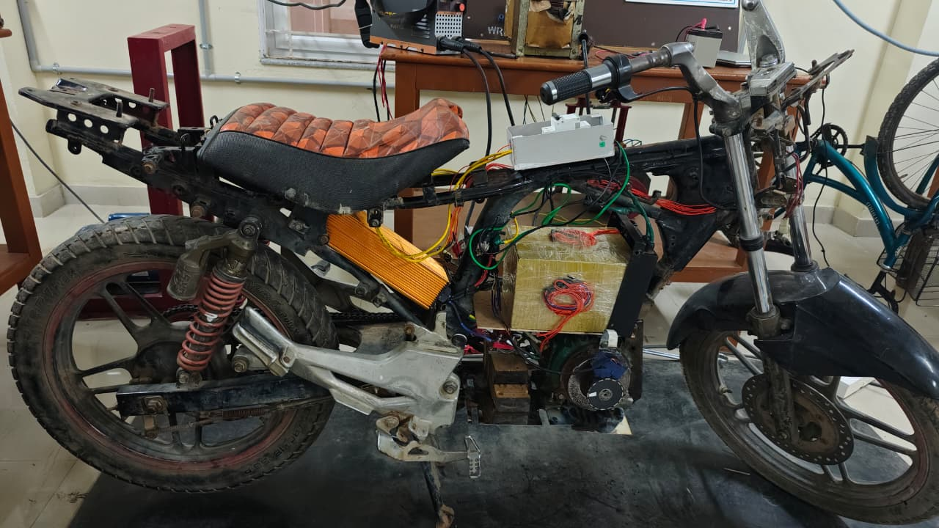
Overview of Battery Pack in Electrical Vechile
A battery pack in an electric vehicle stores electrical energy and supplies power to the motor for driving. It is the main source of energy, making the vehicle run efficiently and sustainably without using fuel.

Slide 4
23 days
16 days
15 days
45 days
30 days
6 days
3 days
3 days
3 days
3 days
7 days
6 days
2025
2026
Project Plan
PROJECT
PLAN
Aug 11
Aug 18
ABSTRACT
Aug 19
Aug 20
LITERATURE
Aug 21
Sep 17
EXPLORING SUITABLE BATTERIES
Sep 18
Sep 20
DOCUMENTATION FOR REVIEW 1
Sep 21
Sep 24
DESIGNING OF BATTERY PACK
Sep 25
Oct 16
TESTING OF BATTERY PACK
Oct 15
Nov 4
DOCUMENTATION FOR REVIEW 2
Nov 4
Nov 6
ADDING BATTERY PACK TO EV
Nov 10
Nov 21
FINE TUNNING THE EV BIKE WITH BATTERY PACK
Nov 24
Dec 15
FINAL PRESENTATION
Dec 22
Dec 31
WRITING A PAPER
Dec 24
Dec 31
Aug
Sep
Oct
Nov
Nov
Nov
Dec
Today

Slide 5
Literature Survey
1.A review of improvements on electric vehicle battery” — A. K. Koech et al., 2024 Comprehensive review of materials, thermal management, and pack-level improvements for EV batteries.
2.“Automotive battery pack standards and design characteristics” — S. Haghbin et al., 2025 (Springer) Survey of mechanical, electrical, safety, and diagnostic requirements for modern automotive battery packs.
3.“A critical review of battery cell balancing techniques” — N. Khan et al., 2024 Detailed review of passive and active balancing methods and their impact on pack life & safety (useful for BMS design).
4.“A review of improvements on electric vehicle battery” / electrothermal comparisons (MDPI) — M. Assi et al., 2025 Electrothermal modeling comparing LFP vs NMC (directly relevant to your chemistry choice and pack thermal design).
5.“Life cycle assessment of battery electric vehicles” — M. S. Koroma et al., 2022 (PMC/MDPI) LCA covering battery production, use, and recycling — good for the “environmental impact” slide.
”.
Key Publications

Slide 6
Existing Implementations – Products| Opensource| GitHub etc
1.BYD Blade battery analyses / feasibility papers — academic and industry analyses explaining BYD blade mechanical layout and safety testing (great for comparing LFP prismatic pack architecture)
2. Mechanical design of battery packs (research projects) — project reports and conference papers focusing on mechanical packaging, busbar routing, and cooling for automotive battery packs.
3. Tesla 4680 / structural pack teardowns and analyses — several teardown analyses & academic studies examine the 4680’s thermal/current collection challenges (good for learning tradeoffs when using large format cells).
`

Slide 7
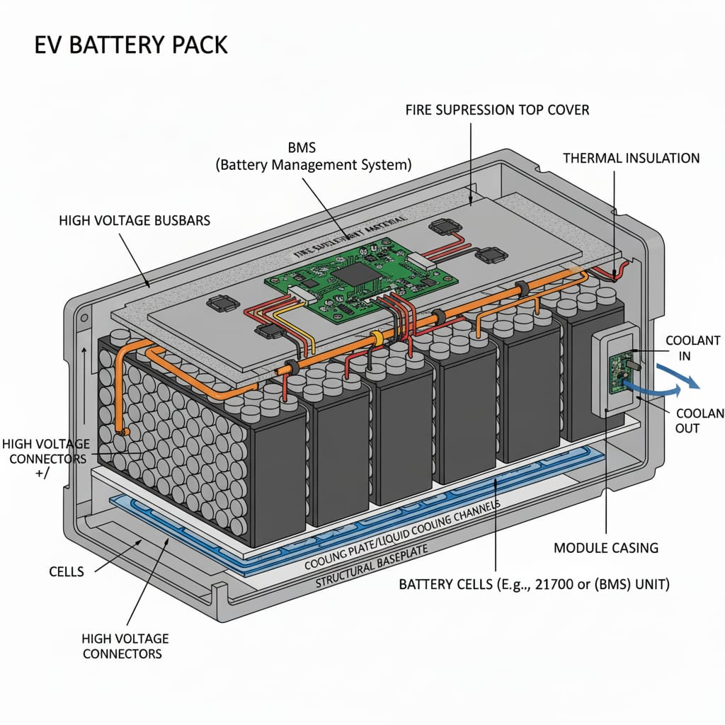
Architecture
EV BATTERY PACK
STRUCTURAL DIAGRAM

Slide 8
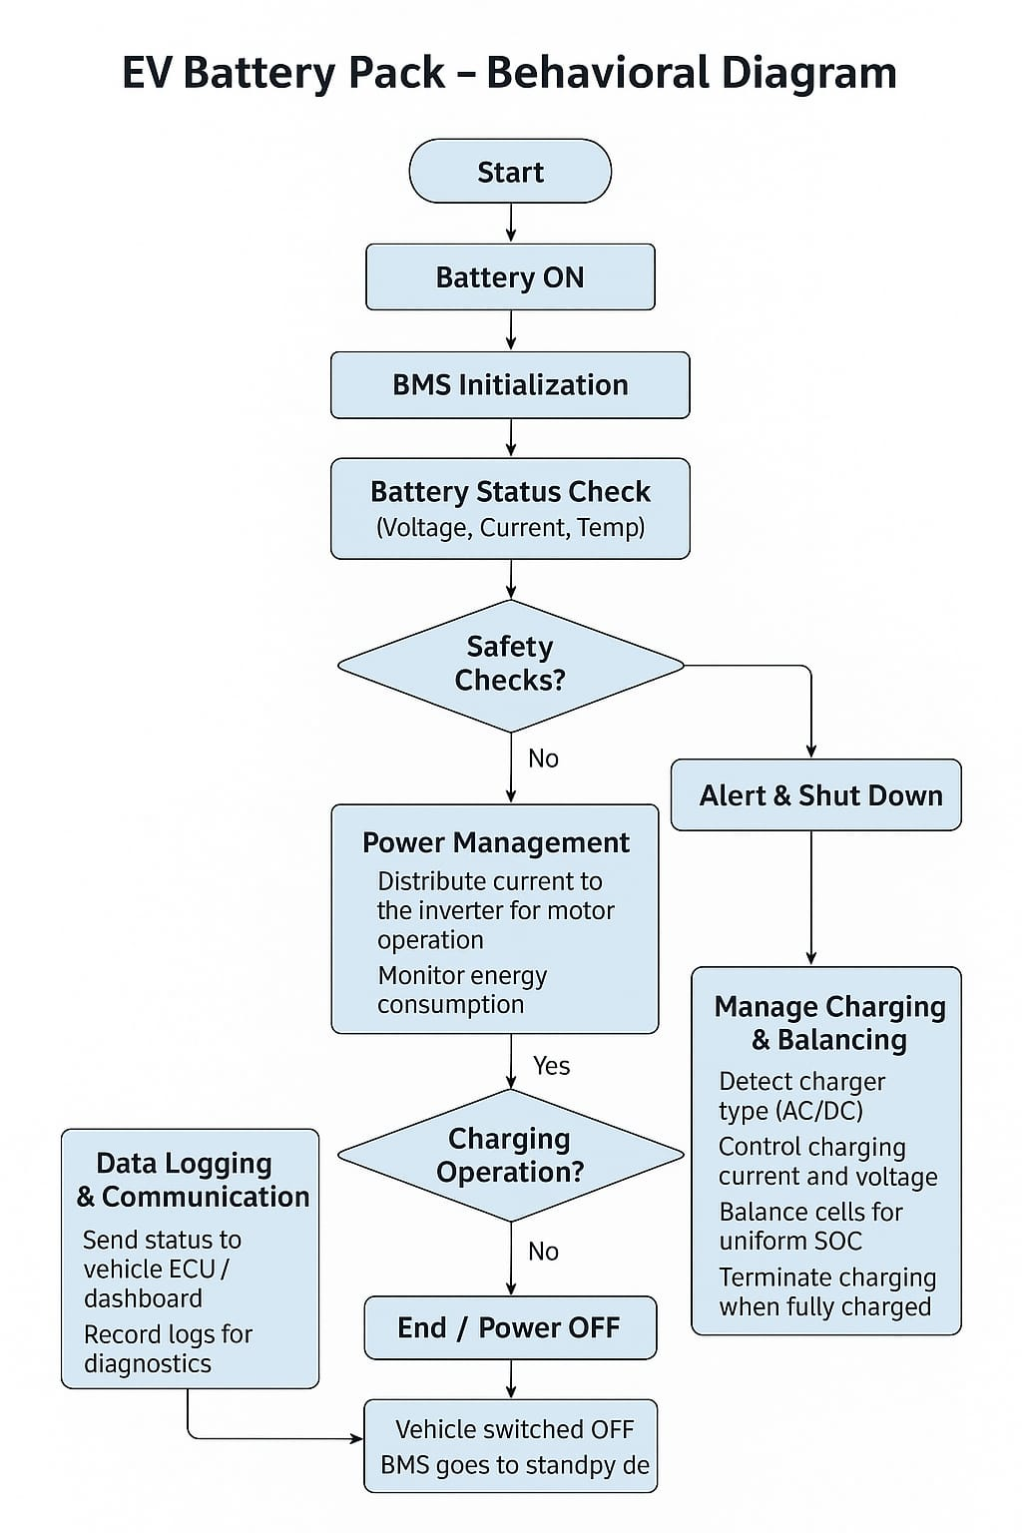
ELECTRIC VEHICLE BATTERY PACK
BEHAVIOUR DIAGRAM

Slide 9

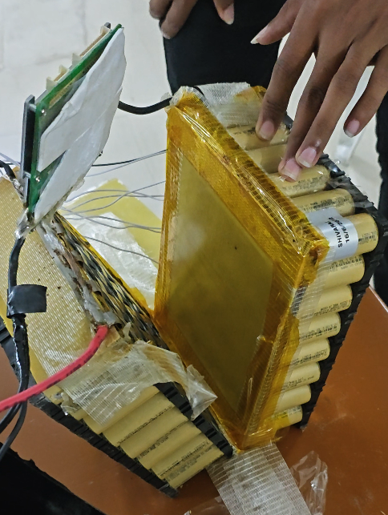
Use Cases & Testing
Use Cases
1.Urban commute (short range): Battery powers vehicle for ~5–10 km daily city travel; moderate discharge rates.
2.Highway driving (longer range & fast charging): Pack supports higher continuous power output and accepts higher charging current for reduced downtime.
3.Emergency shutoff (overheating): BMS detects abnormal temperature rise and disconnects pack to prevent thermal runaway.
Test Cases
1.Range test under different loads: Measure distance traveled at light load (city driving) vs heavy load (hill climb/high speed).
2.Thermal test under high current: Monitor temperature rise when discharging at 3C–5C rates; validate cooling and safety limits.
3.Charging time measurement: Evaluate charging profile (CC–CV), record time to 80% and 100% SOC under standard and fast charging.
4.Safety test – short circuit simulation: Controlled fault test with fuses/BMS protection to verify safe disconnect and no cell damage.

Slide 10
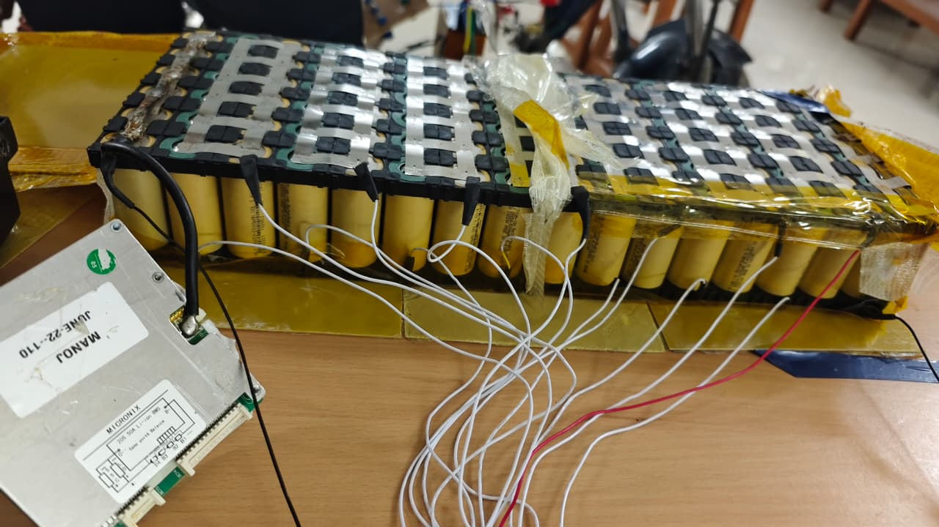
Battery Chemistry in EV Vehicles
– Lithium-ion Batteries
Common Lithium-ion Chemistries Used in EVs
1. NMC (Nickel Manganese Cobalt Oxide – LiNiMnCoO₂)
2. LFP (Lithium Iron Phosphate – LiFePO₄)
3. NCA (Nickel Cobalt Aluminum Oxide – LiNiCoAlO₂)

Slide 11
Battery Pack Components:
Lithium-ion battery packs include the following main components:
Lithium-ion cells – The basic electrochemical unit providing electrical storage capacity. Multiple cells are combined to achieve the desired voltage and capacity.
Battery Management System (BMS) – The “brain” monitoring cell conditions and controlling safety and performance.
Passive components – Provide structure, interconnection, insulation, and cooling.
Enclosure – Houses and protects all internal components.
Thermal management system – Maintains optimal cell temperatures for operation.
Additional electronics – Added features enhancing functionality and integration.

Slide 12

Assembling of lithium battery pack
cell assembles a battery pack. A single battery pack may contain many individual cells.
Firstly, the manufacturer assembles the cells into a rack and wields each cell to the other from both the anode and cathode. The quantity of cells depends upon the AH required. For example, a 50Ah battery will need 15 cells.
After the welding and binding procedure, the manufacturer installs a battery management system BMS that ensures the proper working of all battery components.

Slide 13
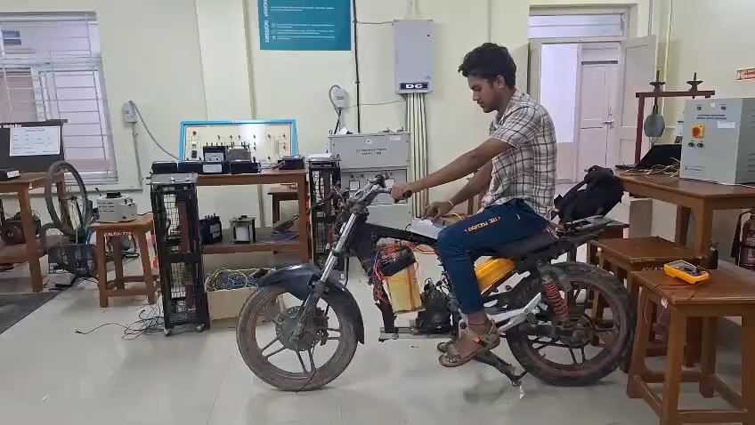
RESULT:
The battery pack for the electric vehicle worked successfully and met all the important requirements. It provided a steady supply of power to the motor and helped the vehicle run smoothly. The battery stored enough energy to support a good driving range without making the vehicle too heavy.
During testing, the battery stayed at a safe temperature, even when the vehicle was used for long periods or charged quickly. This shows that the cooling system worked well and protected the battery from overheating.
The battery also lasted through many charge and discharge cycles with only a small loss of capacity. Safety tests showed that the battery pack was secure and well-protected against problems like short circuits, vibrations, and impacts.
Overall, the battery pack performed well, stayed safe, and proved strong and reliable for use in an electric vehicle.

Slide 14
Conclusion & Future Work
Summary and Conclusion:
The battery pack stands at the core of modern electric vehicles, serving as the primary driver of performance, efficiency, and overall sustainability. Advances in battery technology—particularly in energy density, thermal management, and charging capabilities—have significantly improved the reliability and practicality of EVs, making them a viable alternative to traditional combustion-engine vehicles. As innovation continues, supported by ongoing research, improved manufacturing processes, and expanding recycling solutions, battery packs will only become more efficient, cost-effective, and environmentally friendly. Ultimately, the evolution of EV battery systems is not only transforming the transportation sector but also paving the way toward a cleaner, more sustainable future.
Successfully designed an EV battery pack with required specifications.
Achieved safety & performance goals.

Slide 15
THANK YOU
Have a Great Day !

